Slide 1
Case Study 1:
Cyclistic
Author: Biasotti, Bruno
Date: 9/Oct/2022

Slide 2
Table of Contents
Objective
Data cleaning
Analysis and Insights
Conclusions and Next Steps

Slide 3
Objective
There are two types of riders using Cyclistic. Casual Riders and Annual Members. Annual Members are more profitable
Maximizing the number of annual members will be the key for future growth. We need to understand how casual riders and annual members differ to be able to design a proper market strategy

Slide 4
Data cleaning
Consideration: There are some data entries in the dataset which are blank. The analyst team decided to remove these data entries, as there is enough data to get accurate insights

Slide 5
Analysis
How do both types of riders differ?
We will look into three main points:
Average travel time
Comparison between AVG/day
Total travels registered

Slide 6
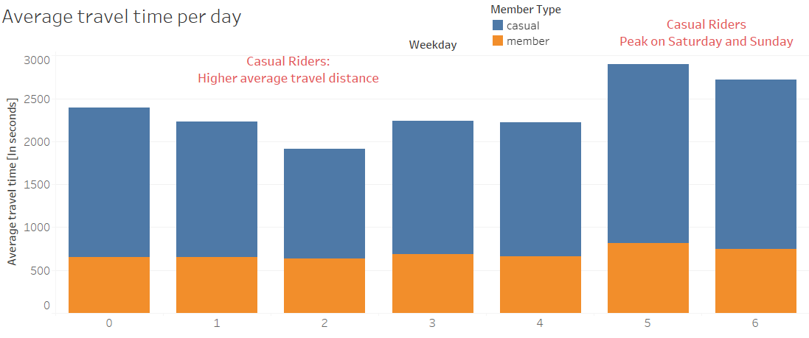
Average travel time per day in Seconds

Slide 7
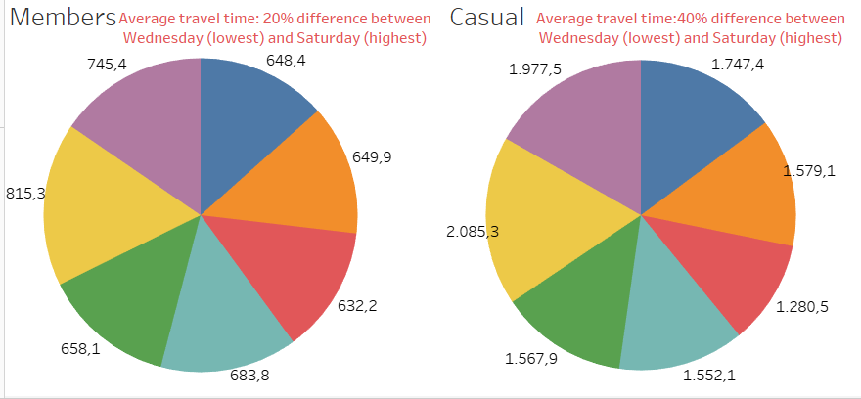
Average per Day

Slide 8
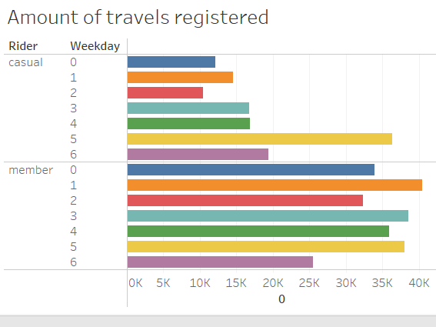
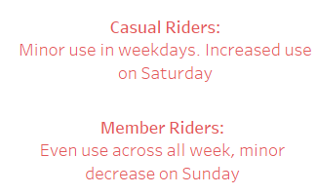
Amount of travels per day

Slide 9
Conclusions
Data shows that casual riders have longer average time, and a great amount of the rides are on Saturday. Casual riders use their bikes for leisure
Annual members have an even distribution across all days of the week. Together with the shorter average travel time, it shows that annual members use their bikes for day-to-day activities, like going to their workplace

Slide 10
Next Steps
Draw a heat map about the travels of both types of riders
Station locations and their disponibility
Anonymous survey to determine target audience

Slide 11
Questions

